Slide 1
Cryptography and Its Network Security CSA5112
Advanced Encryption Standard (AES)
A Modern Symmetric Key Encryption Algorithm
Presented by :
C Sangita(192373059)

Slide 2
Introduction What is AES?
Advanced Encryption Standard (AES) is a symmetric key encryption algorithm.
It was adopted by the U.S. National Institute of Standards and Technology (NIST) in 2001.
AES replaced the older Data Encryption Standard (DES) because DES became vulnerable to attacks.
It is one of the most secure and widely used encryption algorithms today.
Why AES?
High security ,Fast encryption and decryption, Efficient for both hardware and software, Suitable for protecting sensitive information

Slide 3
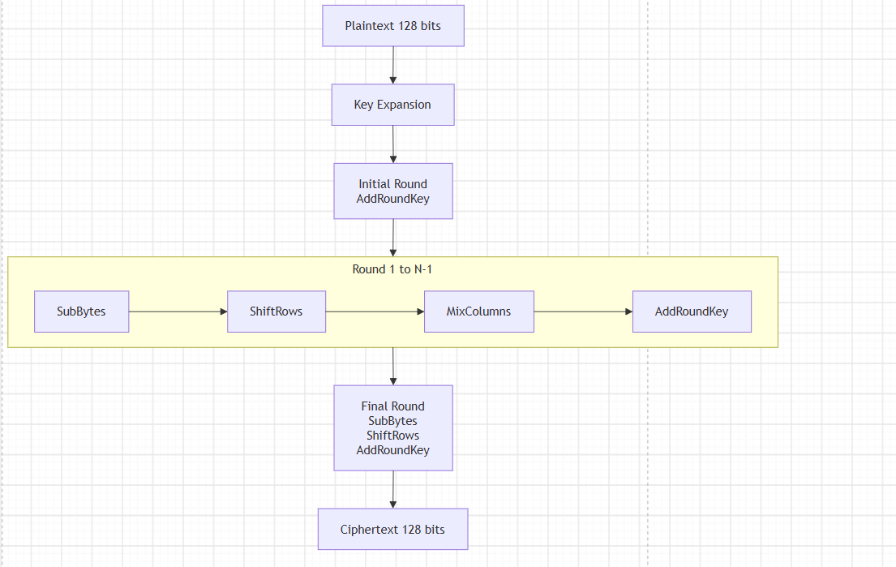
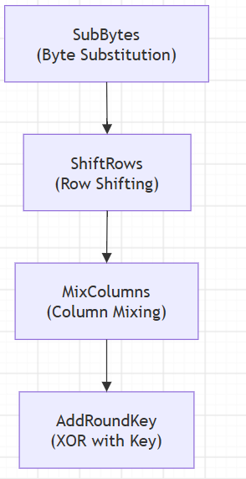
Working of AES
Encryption Process
Round Operations Diagram

Slide 4
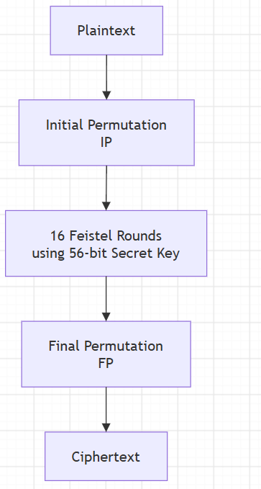
Data Encryption Standard (DES)
Data Encryption Standard (DES) is a symmetric key encryption algorithm.
Developed by IBM and adopted as a U.S. standard in 1977.
Uses the same secret key for both encryption and decryption.
Encrypts data in 64-bit blocks using a 56-bit key.
DES was widely used in banking and government systems before AES.

Slide 5
Difference Between AES and DES
Feature | DES | AES
Full Form | Data Encryption Standard | Advanced Encryption Standard
Year Introduced | 1977 | 2001
Algorithm Type | Symmetric Key | Symmetric Key
Block Size | 64 bits | 128 bits
Key Size | 56 bits | 128, 192, 256 bits
Number of Rounds | 16 | 10, 12, or 14
Security | Less Secure | Highly Secure
Speed | Slower | Faster
Current Status | Obsolete | Global Standard

Slide 6
Features, Advantages, and Applications
Features
Symmetric key encryption algorithm
Advantages
Strong protection against attacks
Applications
Online Banking
128-bit block size
Supports 128, 192 & 256-bit keys
Performs 10, 12 or 14 encryption rounds
Fast encryption and decryption
Efficient in hardware and software
Supports multiple key sizes
Cloud Storage
Wi-Fi Security (WPA2/WPA3)
Secure Messaging Apps

